Slide 1
RESUME INTELLIGENCE
PLATFORM
ML & NLP-Powered Resume Screening and Matching System
Python
scikit-learn
TF-IDF
NLTK
Gradio
Viva Presentation | Machine Learning Project
AADI MARWAH | Reg. No: 23FE10CSE00136 | Sec-C | ASHWIKA BHATNAGAR | Reg. No: 23FE10CSE00381 | Sec-C

Slide 2
Introduction
Context and Motivation
6–8 sec
72%
1000s
Time recruiters spend per resume
Resumes rejected before human review
Applications per job posting
The Challenge
Our Solution
Manual resume screening is slow, biased, and inconsistent
Candidates lack visibility into what skills they are missing
HR teams need scalable, data-driven shortlisting tools
Automated ML pipeline for resume–JD matching
Skill gap analysis with actionable suggestions
Real-time interactive interface via Gradio

Slide 3
Problem Statement
Pain Points in Traditional Hiring
Recruiter Perspective
Candidate Perspective
Manually reads hundreds of resumes daily
Prone to cognitive bias and fatigue
Misses qualified candidates due to time pressure
No standardized scoring method
Cannot efficiently compare all applicants
No idea which skills the JD actually requires
Submits generic resumes to all jobs
Gets rejected without feedback
Cannot quantify how well they match a role
Misses opportunities due to skill gaps
Both parties need a smarter, data-driven bridge — and that's exactly what this platform provides.

Slide 4
Project Objectives
What We Set Out to Build
01
Train & compare multiple ML classifiers (LR, NB, SVM, RF) using cross-validation
02
Implement TF-IDF + cosine similarity for semantic resume–JD matching
03
Extract candidate skills vs. required skills using a custom taxonomy
04
Generate a composite match score and actionable skill-gap suggestions
05
Support PDF, DOCX, and plain text resume uploads
06
Build a real-time interactive Gradio demo with visual analytics

Slide 5
Technology Stack
Tools and Libraries Used
Python 3.x
scikit-learn
NLTK
TF-IDF
Core programming language
ML models, TF-IDF, cross-validation
Stopwords, lemmatization, tokenization
Text feature extraction
Gradio
PyPDF2 / docx
Matplotlib/Seaborn
NumPy / Pandas
Interactive web-based UI
PDF and DOCX file parsing
Charts: gauges, bars, heatmaps
Data wrangling and matrix ops

Slide 6
Methodology
8-Phase System Pipeline
1
2
3
4
Data Generation
Preprocessing
TF-IDF
Model Training
~2500 synthetic resume–JD pairs
Clean, tokenize, lemmatize
Text → Numeric vectors
4 models, 5-fold CV
5
6
7
8
Model Selection
Matching
Skill Extraction
Output
Best F1 score wins
ML prob + cosine similarity
Taxonomy-based gap analysis
Score, verdict, suggestions, charts

Slide 7
System Architecture
How Data Flows Through the Platform
Resume Input
(PDF / DOCX / Text)
File Parser
Text Extraction
Text
Preprocessor
TF-IDF
Vectorizer
ML
Classifier
Cosine
Similarity
Composite
Score
Skill
Extractor
OUTPUT: Score | Verdict | Matched/Missing Skills | Suggestions | Visualizations

Slide 8
Model Training
Multi-Model Approach with Cross-Validation
4 Models Trained
5-Fold Stratified Cross-Validation
1
Logistic Regression
Data split into 5 equal folds, maintaining class ratio
Train on 4 folds, test on 1 fold — repeated 5 times
Mean F1 score computed per model
Model with highest F1 is selected
Retrained on full dataset for deployment
Linear, fast, high baseline
2
Naive Bayes (MultinomialNB)
Probabilistic, best for sparse text
3
SVM (LinearSVC)
Maximum margin, high-dim data
4
Random Forest
Why F1 Score? Because accuracy alone fails on imbalanced data. F1 balances Precision (avoid false positives) and Recall (avoid missed matches).
Ensemble, robust to noise

Slide 9
Results & Analysis
Model Performance and Matching Scores
Matching Score Formula
Score = (ML Prob × 0.5) + (Cosine Sim × 0.5)
≥ 0.70 — Strong Fit
0.50–0.69 — Moderate Fit
0.30–0.49 — Weak Fit
< 0.30 — Not a Fit

Slide 10
Demo & Output
Live Platform Walkthrough
Sample Output — Data Scientist Role vs. ML Engineer Resume
Final Match Score:
88%
Strong Fit ✓
Matched Skills:
Python
Machine Learning
scikit-learn
Pandas
SQL
Data Science
Missing Skills:
TensorFlow
Deep Learning
AWS
Suggestion: Add TensorFlow/Keras projects to resume. Obtain AWS Cloud Practitioner certification.

Slide 11
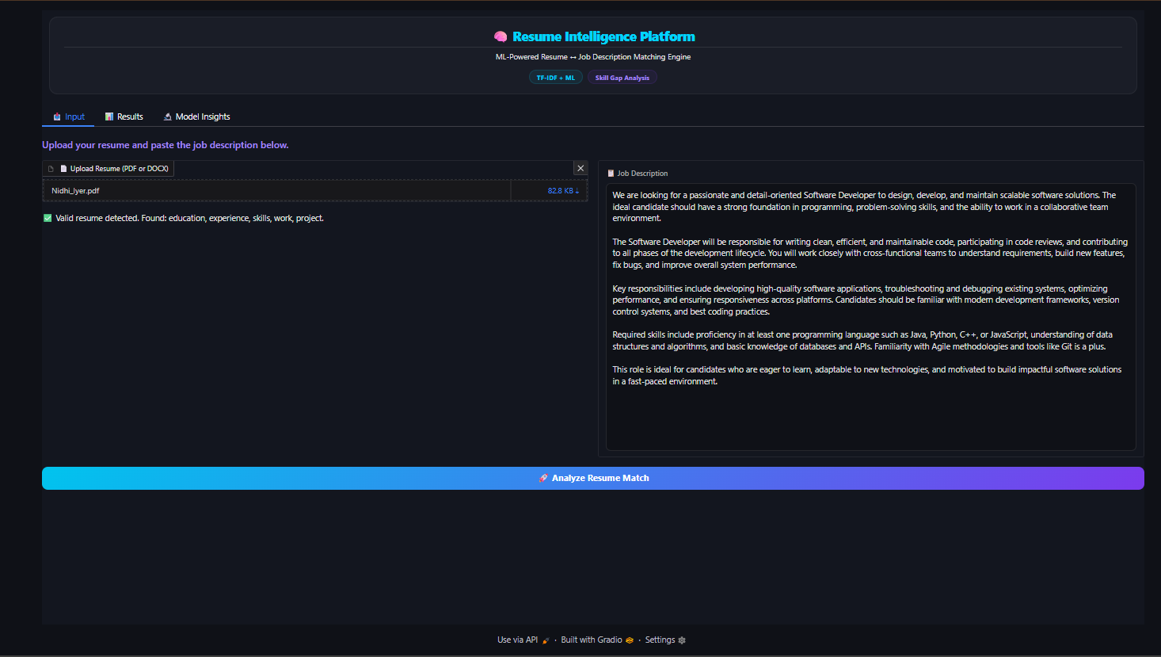

Slide 12
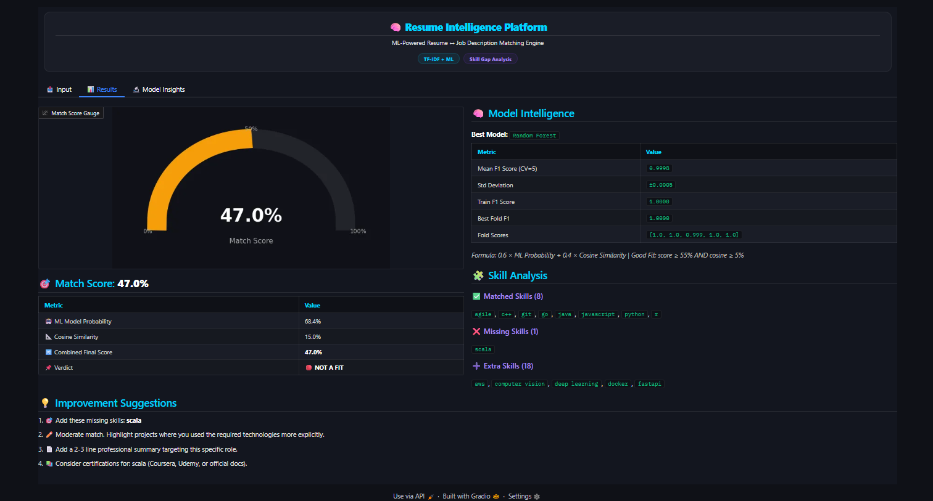

Slide 13
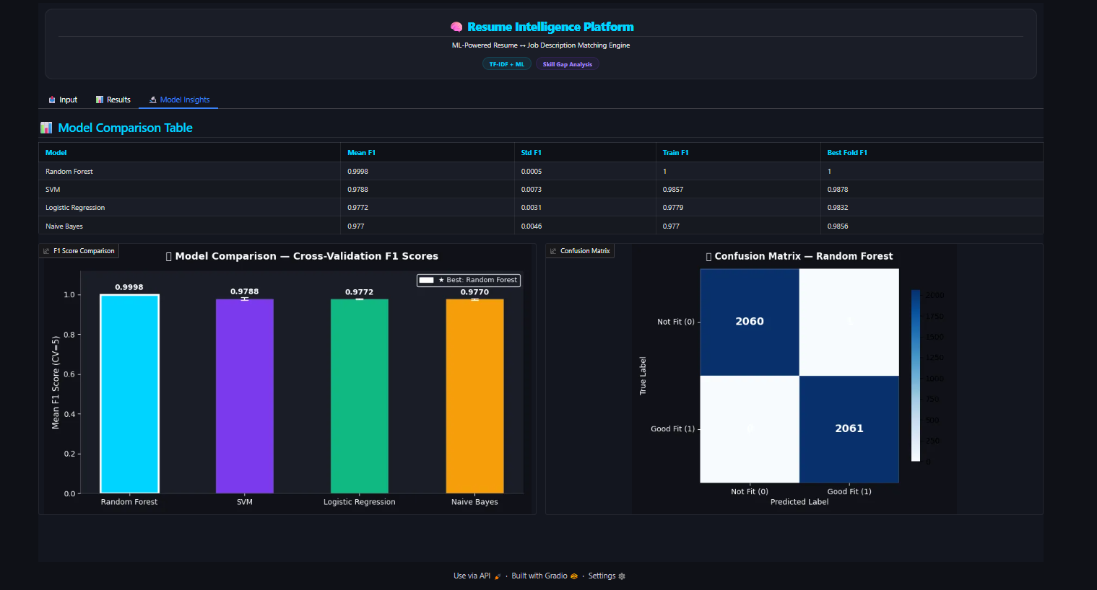

Slide 14
Conclusion
✓ Successfully built an end-to-end ML + NLP resume screening pipeline
✓ 4 classifiers trained; SVM/Logistic Regression achieved best F1 (~0.90+)
✓ Hybrid scoring (ML + Cosine Similarity) outperforms either method alone
✓ Taxonomy-based skill extraction gives precise, actionable gap analysis
✓ Gradio UI enables real-time demo with zero deployment overhead
✓ System is modular, scalable, and ready for real-world integration
This project demonstrates that intelligent, ML-powered tools can transform hiring — making it faster, fairer, and more insightful for both recruiters and candidates.

Slide 15
Future Scope
Where We Can Take This Next
🤖
☁️
📊
BERT / LLM Integration
Cloud Deployment
Real Dataset
Replace TF-IDF with contextual embeddings for semantic understanding
FastAPI + AWS/GCP for production-grade REST API service
Train on anonymized real resume-JD pairs from LinkedIn/Indeed
🌐
🎯
📋
Multi-language Support
NER Extraction
Resume Ranker
Use mBERT or XLM-R to handle non-English resumes
Named Entity Recognition for companies, dates, durations
Rank N resumes against one JD to shortlist top candidates

